Slide 1
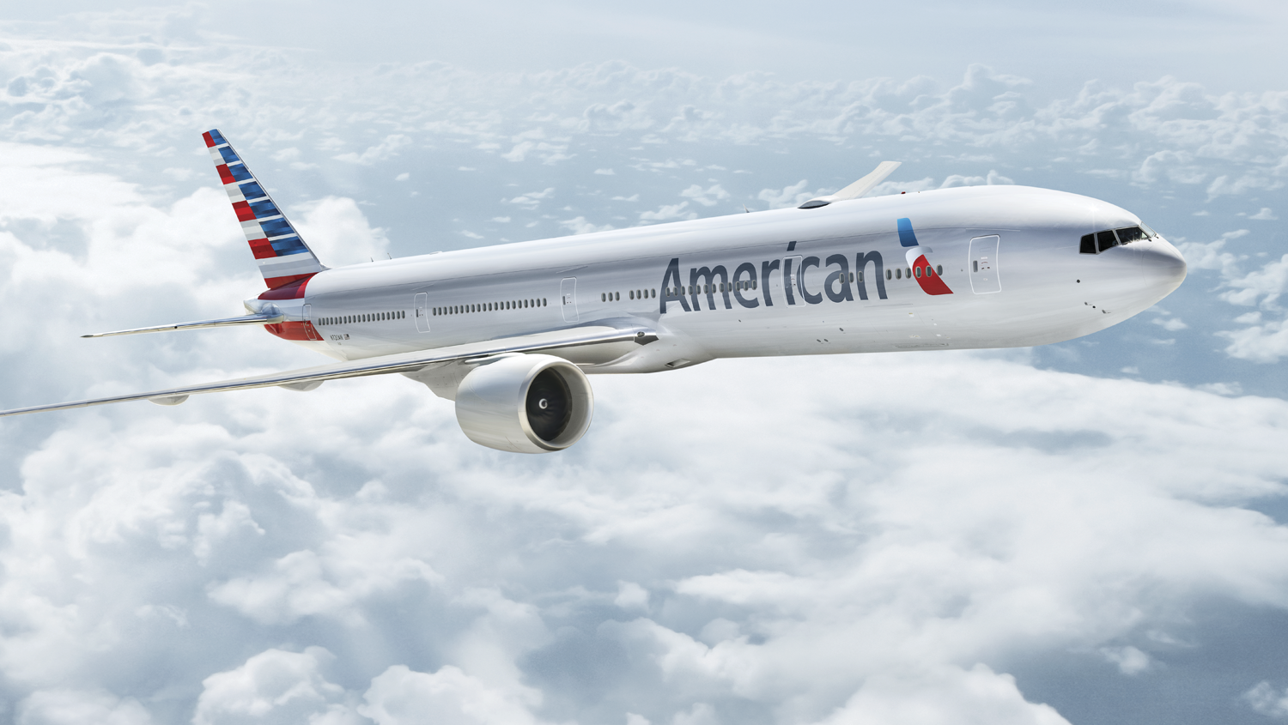

Introducing Airport Technology
Notes:
Welcome to the Airport Technology Station.
As maybe you know Airport Technology refers to all set of applications which are used at the airport by the company employees to support all the activities around the airport, for example the agents that provide support to the travelers or also it covers all applications that are used by the travelers themselves for specific a lot of actions such us do a check-in, change a reservation or buy specific products offer by AA.
Which is the core workload of the offshore team.
We can imagine how critically are these applications for our customer, right? They need to offer a great customer experience but also at the same time be efficient and to provide accurate and just in time information.
Well, take a look on how HP Apps is delivering application development services.

Slide 2
Log Filewalker - Introduction
LFW is a parsing tool for SSM client (Gateside, SSM) log files.
It analyzes log files and provides a detailed report of the sequence of events found, organizes them in a tree-based structure, and provides a UI that allows to go through the log file in an easy way.
Users: SSM developers and testers.
Written in Java 1.6

Slide 3
Log Filewalker - Features
Quick parsing (>3.5 MBs).
Opens multiple files.
Auto-scroll to selected event (from tree to log file text).
Inverse auto-scroll (from log file text to tree)
Log file, Application session, user session and State statistics.
Line wrapping avoids horizontal scrolling.
Word searcher.

Slide 4
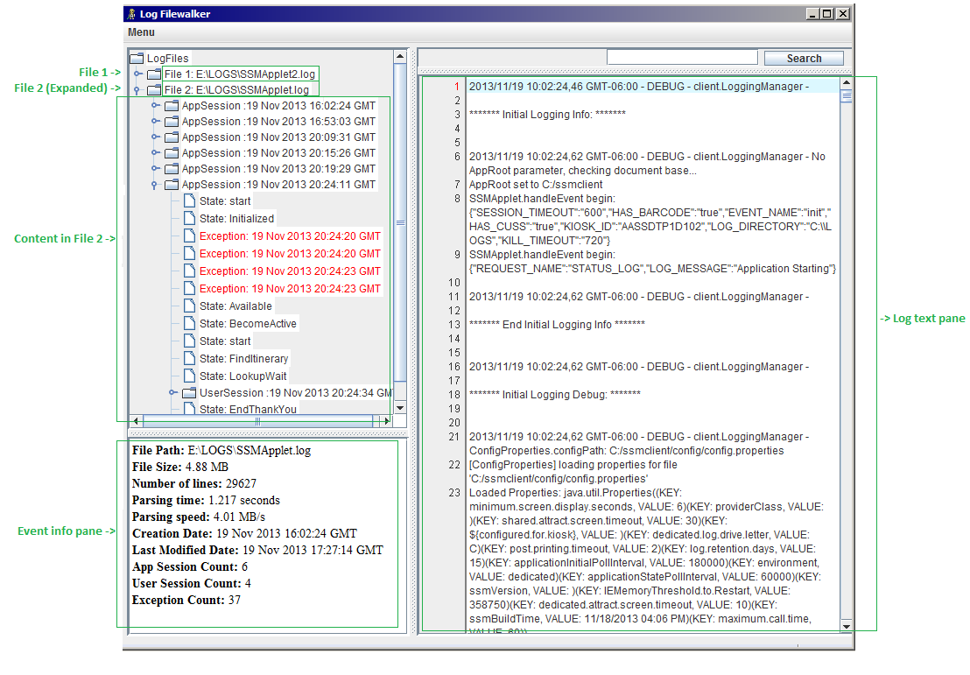


Slide 5
Log Filewalker – Future Enhancements
Short term:
Complete the configuration menu in order to provide personalized parsing options, among other features.
Upload to a repository and provide access to other HP/AA programmers.
Generate complete project documentation.
Full code clean an enhancement. Minor bug fixes.
Enhance memory usage.
Long term:
Implement ability to parse server log files.

Slide 6
Thank you

